Slide 1




Thyroid Disease Detection

Slide 2

Upendra Kumar

Slide 4
At least a person out of ten is suffered from thyroid disease in India. The disorder of thyroid disease primarily happens in the women having the age of 17–54. The extreme stage of thyroid results in cardiovascular complications, increase in blood pressure, maximizes the cholesterol level, depression and decreased fertility.
The hormones, total serum thyroxin (T4) and total serum triiodothyronine (T3) are the two active thyroid
hormones produced by the thyroid gland to control the metabolism of body. For the functioning of each cell and each tissue and organ in a right way, in overall energy yield and regulation and to generate proteins in the ordnance of body temperature, these hormones are necessary .
The basis of classification of thyroid disease is euthyroidism, hyperthyroidism and hypothyroidism which are denoting normal, excessive or defective levels of thyroid hormones. The state euthyroidism depicts the normal production of thyroid hormones and normal levels at the cellular level by the thyroid gland. The state hyperthyroidism is clinical symptom due to excessive circulation and intracellular thyroid hormones. The state hypothyroidism is most of due to the lack of thyroid hormone generation and poor alternate therapy.
Cure of disease is a regular concern for the health care practitioners, and the errorless diagnostic at the right time for a patient is very important. Recently, by some advanced diagnosis methods, the common medical report can be generated with an additional report based on symptoms. The different questions like ‘‘what are the causes for affecting the thyroid?’’, ‘‘Which age group of people are affected due to thyroid?’’, ‘‘what is the relevant treatment for a disease?’’. All these answers we can find on implementing machine learning methods on Health care data. Health care data can be processed and after implementing with certain methodologies; it can provide information that can be used in diagnosis and treatment of diseases more efficiently and accurately with better decision making and minimizing the death risk.

Slide 5
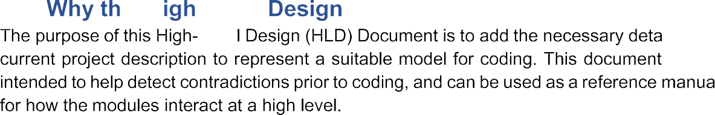
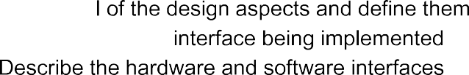
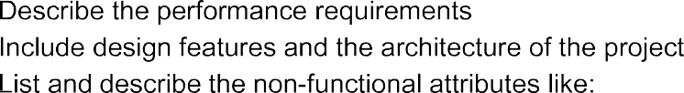

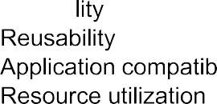
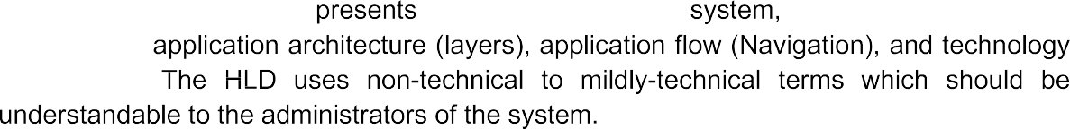

Slide 6


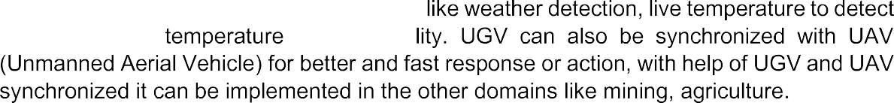
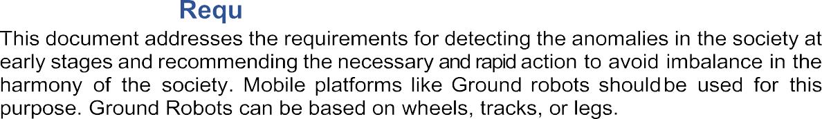
The Thyroid Disease Detection solution system is a data science-based machine learning model which help us to detect the thyroid disease in the male and female and take necessary action.
To create an AI solution for detecting thyroid disease and to implement the following use cases.
To detect thyroid disease in healthy person.
To detect thyroid disease in unhealthy person.
Here unhealthy person means person already affected by thyroid disease.
The solution proposed here is a data science model based on machine learning can be implemented to perform above mention use cases. In first use case , we will take input from a healthy person who is not suffering from thyroid disease and see whether proposed solution is going to detect it or not. And in second use case, we will take input from an unhealthy person, already suffering from thyroid disease and check our solution whether it is performing or not in right way.

Slide 7

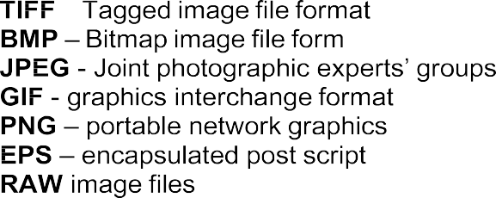

Slide 8
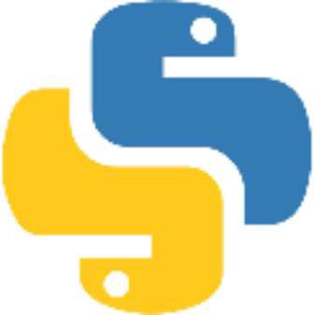


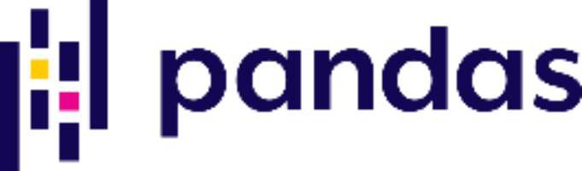
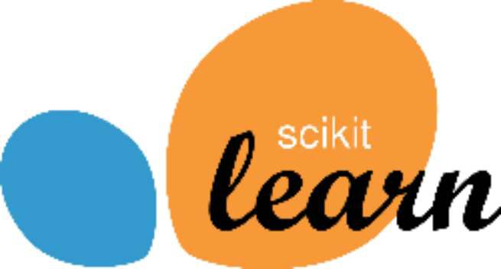

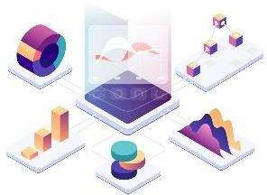


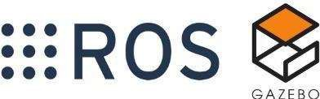
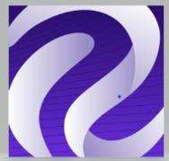


Slide 9
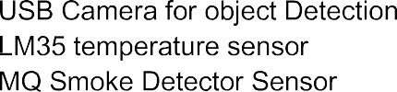


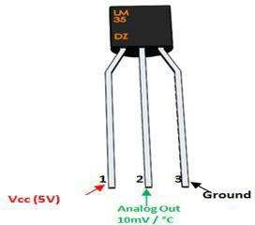
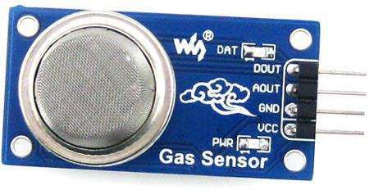
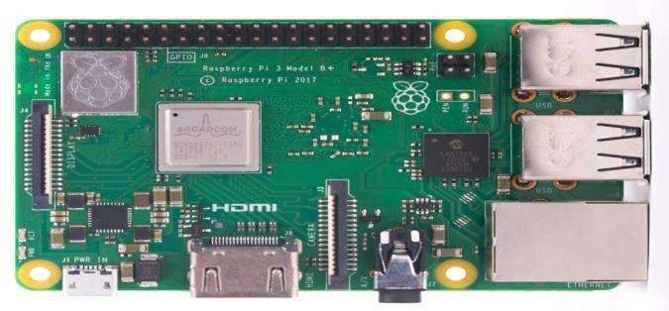
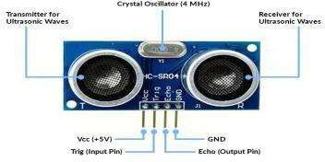
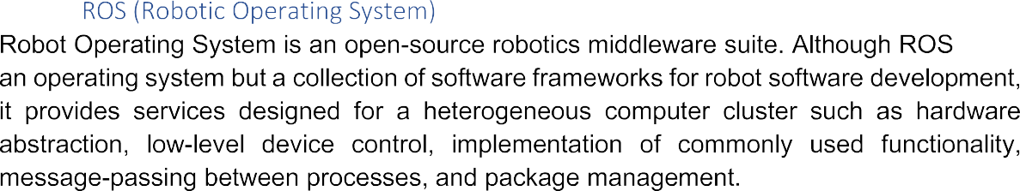

Slide 10

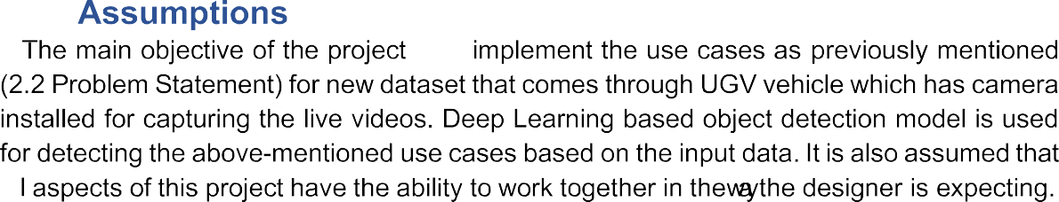

Slide 11


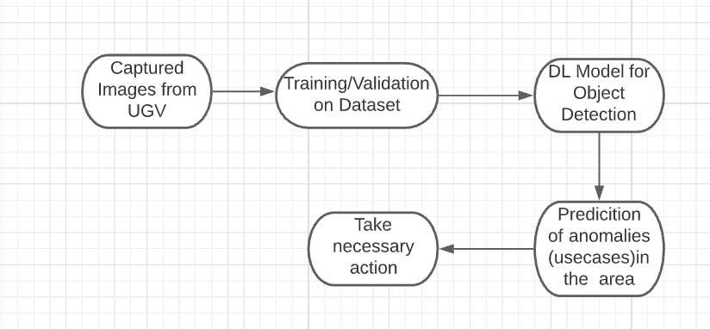

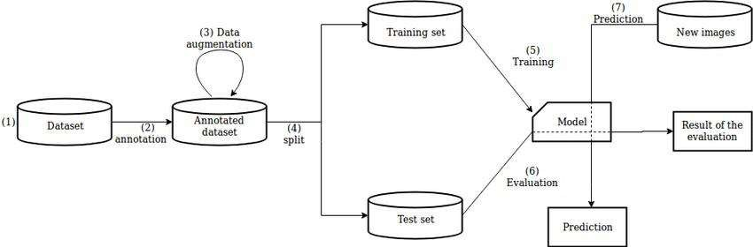

Slide 12

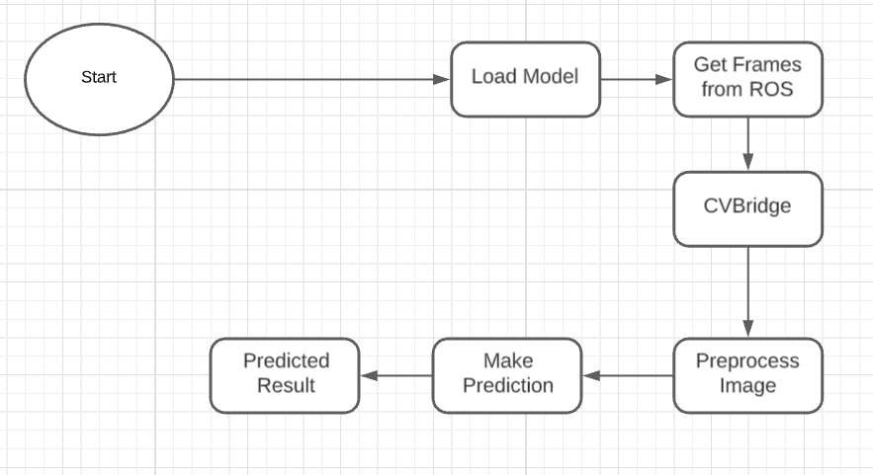
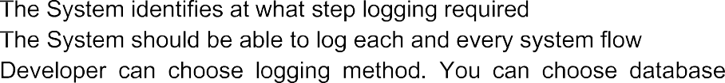
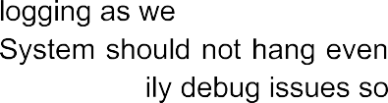


Slide 13

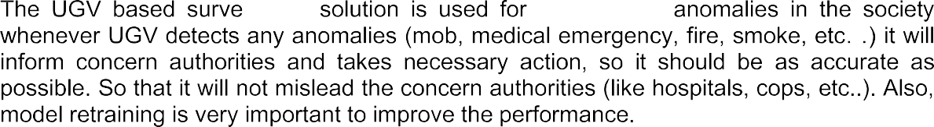
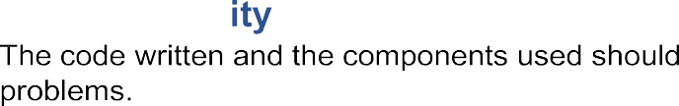
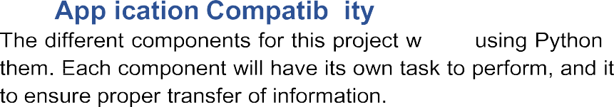




Slide 14




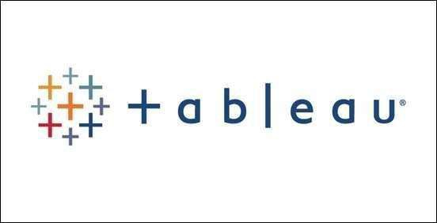




Slide 15
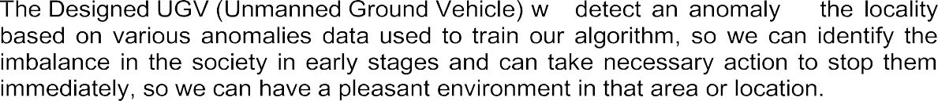

Slide 16



